Slide 1
Eliciting Requirements
(Fall 2019)
Software Requirements Analysis
Week 4
Software Requirements Analysis

Slide 2
Agenda
Review the Previous Lecture
Eliciting requirements
  Challenges of requirements elicitation
  Techniques for eliciting requirements
Use Cases: requirements in Context
Key Points
Next?
Software Requirements Analysis

Slide 3
Analyzing the Problem – the Five Steps
Gain agreement on the problem definition.
Understand the root causes—the problem behind the problem.
Identify the stakeholders, especially users.
Define the solution system boundary.
Identify the constraints to be imposed on the solution.
Software Requirements Analysis
Notes:
Order of the steps is not mandatory.
Doing all of the steps is important.
Allow iteration among steps.
(Notice overlap with other “Team skills”.)

Slide 4
Why Do Problem Analysis?
Problem v.s. Symptom
In fact, there might not even be a problem!
Software Requirements Analysis

Slide 5

Eliciting requirements
Problem
Needs
Problem Domain
Features
S/W Requirements
Solution Domain
Software Requirements Analysis

Slide 6
Requirements Elicitation
Sometimes called requirements discovery
Involves technical staff working with customers to find out about the application domain, the services that the system should provide and the system’s operational constraints
Involves stakeholders
Software Requirements Analysis

Slide 7
Stakeholder need is …
A reflection of the business, personal, or operational problem that must be addressed in order to justify the use of a new system
Software Requirements Analysis

Slide 8
A Feature is …
A service the system provides to fulfill one or more stakeholder needs
Examples:
Software Requirements Analysis
Notes:
Abstract and helpful constructs for early product scope management and the related negotiation and trade-off processes.
Easy to describe and list.
Prioritize as “implement immediately”, “reject entirely”, “investigate further”, “defer to a later release”.

Slide 9
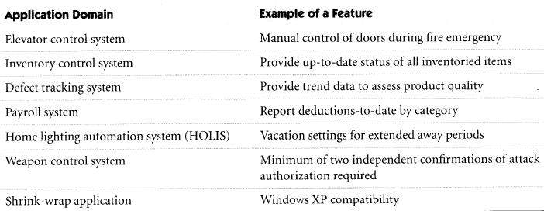
Software Requirements Analysis

Slide 10
Attributes of Product Features
Some common attributes:
  Unique Identifier
  Source
  Benefit
  Priority
  Version Number
  Risk
  Status
  …
Software Requirements Analysis

Slide 11
Challenges of Requirements Elicitation
Barriers to Elicitation:
  “Yes, But”: we are humans!
  “Undiscovered Ruins”: identify all holders of otherwise undiscovered requirements
Cure?
  “User & Developer”: communication gap
Continuous User and Stakeholder
Involvement
Software Requirements Analysis
Notes:
Ask the prospective stakeholders!

Slide 12
Elicitation techniques
Specific techniques which may be used to collect knowledge about system requirements
    Interviews and questionnaires
    Requirements workshop
    Brainstorming sessions and idea reduction
    Storyboards
Software Requirements Analysis

Slide 13
Interviewing
Ask Context-Free Questions
Explore the suggested solutions
Interview:
  Goal: to gain knowledge of the problem domain & user expectations
  Be ready with the questions!
  Take notes
Software Requirements Analysis
Notes:
There is no substitute for an interview

Slide 14
Gathering Information About...
The organisation
  goals, structure, functional units, policies
The people
  authority, duties, relationships, information, needs
The work
  tasks, work flows, procedures, schedules, volumes, performance criteria
The work environment
  work areas, resources
Software Requirements Analysis

Slide 15
Gathering Information From...
Documentation
  charts, manuals, job descriptions, forms, reports
System users and managers
External sources
  other companies, vendors, publications, seminars, workshops, on-line data services
Software Requirements Analysis

Slide 16
Interviews
The requirements engineer or analyst discusses the system with different stakeholders and builds up an understanding of their requirements.
Identify
  work flows
  factors that influence the operations of systems
  the elements (documents, procedures, policies etc.) that make up systems
Software Requirements Analysis

Slide 17
Types of Interviews
Closed interviews. The requirements engineer looks for answers to a pre-defined set of questions
  goal-directed and systematic
Open interviews. There is no predefined agenda and the requirements engineer discusses, in an open-ended way, what stakeholders want from the system.
  Appropriate when we want to explore an issue
  establish rapport and obtain a broad view
Software Requirements Analysis

Slide 18
Interviewing essentials
Interviewers must be open-minded
Stakeholders must be given a starting point for discussion
Interviewers must be aware of organisational politics
Software Requirements Analysis

Slide 19
Interview Steps
Preparing
Planning
Opening and Closing
Conducting
Following up
Software Requirements Analysis

Slide 20
Preparing for the interview
Review
  organisation reports
  annual reports
  statements of departments goals
  long-range planning goals
  existing procedure manuals
  systems documentation
  understand their language
Software Requirements Analysis

Slide 21
Planning of Interviews
Identify sources
prepare
  purpose, outline of points to cover
appointments
prepare the interviewee
  points to cover, useful documents
Software Requirements Analysis

Slide 22
Conducting
Judge content and not delivery
withhold evaluation and response
be flexible
work at listening
resist distractions
keep your mind open
listen for ideas
Software Requirements Analysis

Slide 23
Opening and closing and Following Up the interview
Opening
  Introduce yourself
  state the purpose of the interview
Closing
  briefly summarise the areas that have been discussed, highlight important points and your understanding of them
  thank the interviewee for the time
  Ask closed questions
Follow up
  Document the results
Software Requirements Analysis

Slide 24
Requirements Workshop
Gather all key stakeholders together for a short but intensely focused period.
Use an outside facilitator
Brainstorming and Idea reduction
Output: list of possible features & attributes
Follow-Up
Software Requirements Analysis

Slide 25
Meetings: Planning
Define clearly the expected results or outcomes of the meeting
Find if possible a way to eliminate the need for the meeting
  do we really need the outcome of this meeting at this moment?
  Is there another more efficient and more effective way to accomplish what is to be accomplished by holding this meeting?
  If yes and no are the answers to the two questions then proceed
Software Requirements Analysis

Slide 26
Meetings: Planning
Prepare agenda for the meeting
  reasonable time allocation for each topic
  circulate at least two days before the meeting
    to allow time for the attendees to prepare, comment and make schedule arrangements
  identify and notify required meeting attendees. Must have the right people
    the appropriate information and knowledge to support meeting goals and objectives
    the authority (direct or delegated) to make decisions and commitments if required by the meeting’s goals and objectives
    the need to understand what is going on and the rationale behind any decisions or commitments made during the meeting
Software Requirements Analysis
Notes:
Meeting location considerations
room size, lighting, noise, temperature, humidity can distract
need for audio/visual aids in working order
Start and Finish on time
Record and publish minutes
Have handouts ready for distribution
review the agenda, meeting goals and objectives first
discourage interruptions and deflections from the topic at hand
follow the agenda schedule as closely as possible

Slide 27
Storyboarding
Targets “Yes, But” syndrome
Early review of the UIs with the stakeholders
Work through the details of the human-to-machine interface
  Who-What-How
Software Requirements Analysis
Notes:
High volatility area
Each user tends to have a different idea

Slide 28
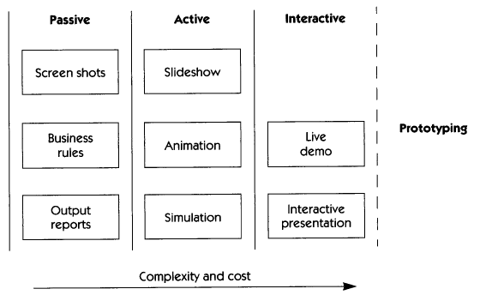
Storyboards Types
Software Requirements Analysis

Slide 29
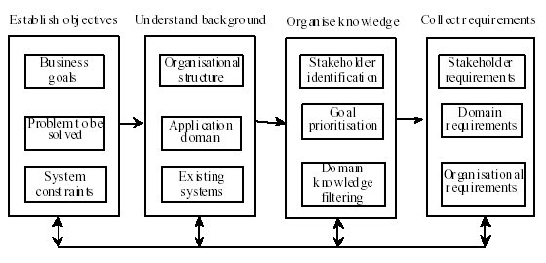
Elicitation Activities: Overview
Software Requirements Analysis

Slide 30
Checklist
Is there a written request for the work to be done?
Does the written request outline the problem to be solved, the output to be produced, and the input that will be required?
Is the person doing requirement elicitation familiar with local jargon, business issues, personnel and politics?
Has an agenda for the meeting been established; have ground rules for the meeting been defined; have all people who need to attend been invited?
Has the behavior of the system been fully defined (from the customer's viewpoint) under various operating conditions?
Have user interface characteristics been discussed and defined?
Have constraints and limitation been identified?
Have requirements been ranked by importance to the customer?
Have review(s) been conducted for all information collected as part of requirements elicitation?
Software Requirements Analysis

Slide 31
Scenario-based Requirements Elicitation
  A process of eliciting and describing the future use of the system in its context;
  Describes the use of the system in terms of a series of interactions with between the user and the system
Software Requirements Analysis

Slide 32
Role of Scenarios
To communicate with the client
use scenarios in problem statement and in requirements specification
Software Requirements Analysis

Slide 33
Scenarios
Scenarios are stories which explain how a system might be used. They should include
  a description of the system state before entering the scenario
  the normal flow of events in the scenario
  exceptions to the normal flow of events
  information about concurrent activities
  a description of the system state at the end of the scenario
Software Requirements Analysis
Notes:
Scenarios are examples of interaction sessions which describe how a user interacts with a system
Discovering scenarios exposes possible system interactions and reveals system facilities which may be required

Slide 34
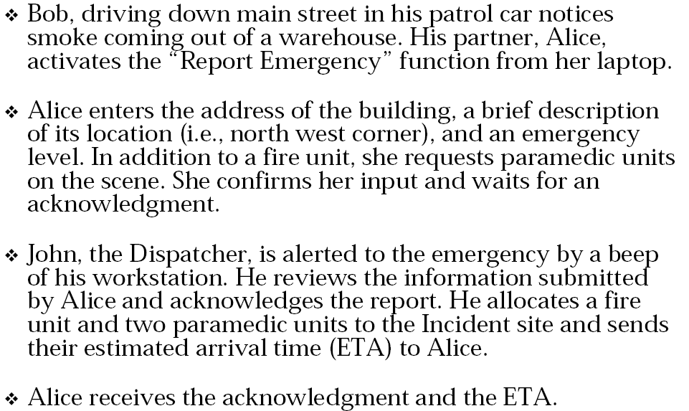
Example of Scenario: Warehouse on Fire
Software Requirements Analysis
Notes:
Observations about Warehouse on Fire Scenario
v Concrete scenario
 Describes a single instance of reporting a fire
incident.
 Does not describe all possible situations in which a
fire can be reported.
v Participating actors
 Bob, Alice and John

Slide 35
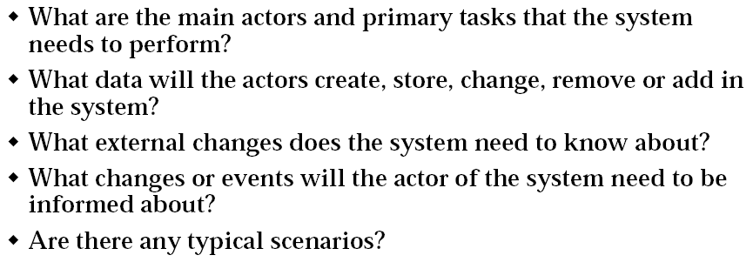
Finding Scenarios
Software Requirements Analysis

Slide 36
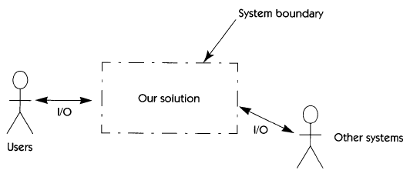
System Boundary is the Context
System Boundary defines the border between the Solution (our system) and the Real World (things that interact with our system).
World partitioned (i.e. no sharing) in two
  Our system
  Things that interact
  with our system.
Software Requirements Analysis

Slide 37
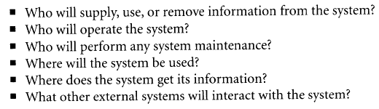
How to identify the actors?
  The following questions might be helpful:
Software Requirements Analysis

Slide 38
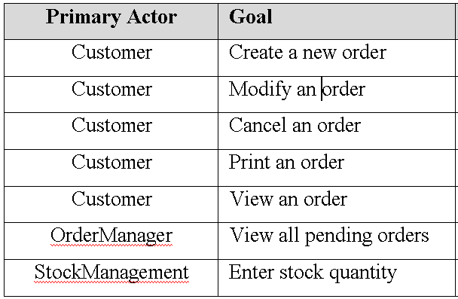
Actors - Goals
Software Requirements Analysis

Slide 39
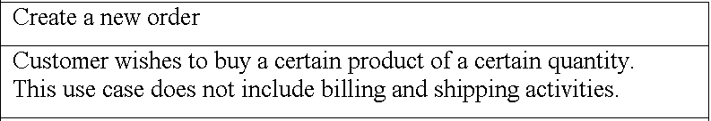
Goal Example
Software Requirements Analysis

Slide 40
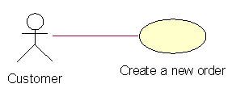
Goals - Use-Cases
Use Cases: a technique for capturing the functional requirements of the system
Definition: A use case describes the typical interactions between the users of a system and the system itself that yield a result of value to the users
Useful for certain classes of systems
Software Requirements Analysis

Slide 41
What is a Use Case?
Think of a Use Case as being
  A “story” of actors making use of the system (to be developed) to fulfill their goals.
A use case contains a set of scenarios
Scenario describes sequences of actions a system performs that yield an observable result of value to a particular actor
Encourages user goal oriented thinking …
Software Requirements Analysis

Slide 42

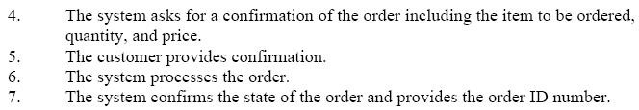
Create an Order Main Scenario
Software Requirements Analysis

Slide 43
More on Scenarios
a single and complete sequence of steps describing an interaction between a user and a system
  Initiated by an actor
  Results in either success or failure
Types:
  Main success (“happy day”) scenario
  Alternative (extensions, or alternate courses of behavior) scenarios
Software Requirements Analysis

Slide 44
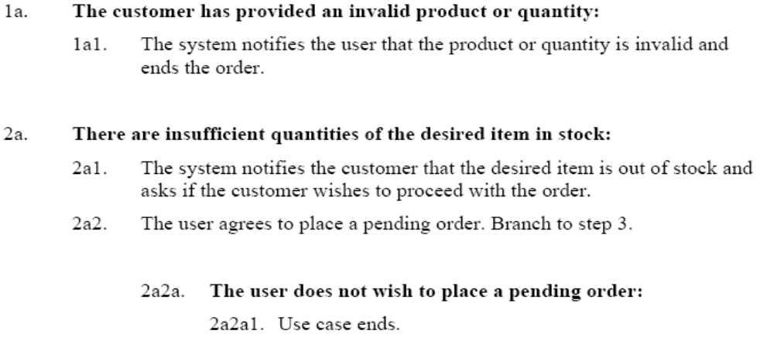
Create an Order: Some Alternative Scenarios
Software Requirements Analysis

Slide 45
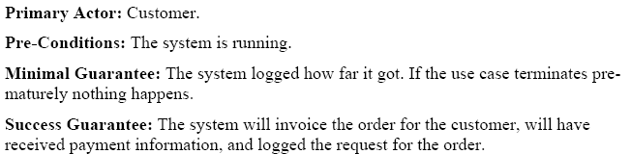
Use Case: Pre- and Post-Conditions (Create an Order)
Software Requirements Analysis

Slide 46
某大型通信设备企业需求开发活动
客户需求分类
需求收集渠道

Slide 47
客户需求分类：$APPEALS解释
$APPEALS是一种了解客户需求的、确定产品市场定位的工具。一般是使用在市场规划和产品规划的细分市场中，因为可以从多个维度，不同的权重来分析需求。
$APPEALS方法是IBM在IPD(集成产品开发，Integrated Product Development, 简称IPD)总结和分析出来的客户需求分析的一种方法。

Slide 48
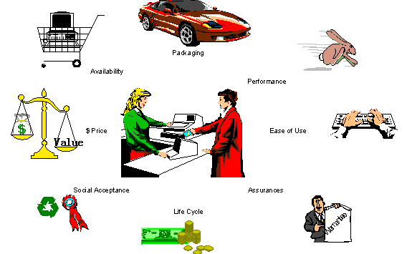
客户需求分类：$APPEALS解释
$APPEALS是英文缩写，表示客户购买标准的8个方面：
$-产品价格（Price）；
A-可获得性（Availability）；
P-包装（Packaging）；
P-性能（Performance）；
E-易用性（Easy to use）； •
A-保证程度（Assurances）；
L-生命周期成本（Life cycle of cost）； •
S-社会接受程度（Social acceptance）。

Slide 49
$APPEALS要素描述
客户$APPEALS 要素 | 要素描述
$价格 | 这个要素反映了客户为一个满意的产品/交付希望支付的价格
A可获得性 | 这个要素描述了客户在产品可获得性方面的要求
P功能/性能 | 这个要素描述了对这个交付期望的功能和特性
P包装 | 这个要素描述了期望的特性和外观等视觉特征
E易用性 | 这个要素描述了交付的易用属性
A保证性 | 这个要素通常反映了在可靠性、安全和质量方面的保证
L生命周期成本 | 这个要素描述了所有者在使用的整个生命周期的成本
S社会接受程度 | 这个要素描述了影响购买决定的其他因素

Slide 50
1、$-价格
价格包括：设备购买价、付款方式、工程服务费用、外协分包商费用、折扣及其它优惠、运输费
  设备购买价：设备购买价格
  付款方式：分期付款、付款期限、融资
  工程服务费用：包括安装、保修、培训
  外协分包商费用：分包商、交钥匙工程及其他项目包括的配套设施
  折扣及其它优惠：设备、备件、服务上的折扣
  运输费：运输费和运输保险

Slide 51
2、A-可获得性
可获得性包括：到货时间、安装时间、试运行情况、发货齐套率、当地销售点、代理商
  到货时间：从签订合同到收到货时间
  安装时间：从安装到初验时间
  试运行情况：初验到终验的时间
  发货齐套率：发货齐套
  当地销售点：直销和当地服务
  代理商：代理商

Slide 52
3、P-包装
包装包括：机柜设计、布线、噪音、外观、运输包装
  机柜设计：标准机柜尺寸，承重，易拆卸，易扩容，抗震性
  布线：布线整齐，符合客户布线规范和业界标准
  噪音：低噪音
  外观：人性化设计（拉手条，显示灯），与现有的协调性，机柜标志和标签指示明显
  运输包装：包装箱环保，易打开（防受伤），保护机柜，包装箱上麦头标志易识破，易运输，易储存

Slide 53
4、P-性能
性能包括：处理能力、互通性、多业务、容量、接入方式、融合、可运营可管理性、组网能力
  处理能力：处理能力（业务处理能力和转发速度）
  互通性：提供标准化的协议，信令和接口支持，与其他网络互通（如接入网关，A2P，中继网关等）
  多业务：提高多种业务，如分组话音、内容提供，如IP HOTEL等
  容量：交换容量，端口数
  接入方式：系统和用户/其他网络之间可用多种接入方式，如：XDSL，LAN，CABLE MO/FE<number>&POS
  融合：在单一的网络上，同时融合数据、语音、图象业务
  可运营可管理性：用户管理，AAA和其他运营和管理的要求
  组网能力：灵活组网能力

Slide 54
5、E-易用性
易用性包括：易于维护、兼容性、业务包、可扩展性、高集成度、统一网管、环境适应性、安全性
  易于维护：易于操作和维护
  兼容性：与现有设备兼容（前向/后向）
  业务包：个性化解决方案，可编程
  可扩展性：易于功能升级
  高集成度：系统集成度，单板端口密度大
  统一网管：以相同的风格对所有部件进行管理的能力，系统具备分级管理权限，提供向上开放的网管接口
  环境适应性：对环境的温度、电压不稳、电磁干扰等适应能力
  安全性：防止获取未授权用户信息

Slide 55
6、A-保证
保证包括：投资回报、投资保护、支持、可靠性、文档、保修服务、战略伙伴关系
  投资回报：投资回报情况（回报周期和回报率）
  投资保护：适合未来的技术标准，避免过快淘汰
  支持：24小时热线，本地支持，INTERNET支持，快速响应，备板、备件支持，单板维修
  可靠性：NTBF、MTTR，备份保护，数据存储，过载控制
  文档：清晰完整的系统文档，工程文档，培训文档，维护文档
  保修服务：保修期，保修项目
  战略伙伴关系：供应商可提供长期的合作，能够长期提供诸如产品升级，后续产品

Slide 56
7、L-生命周期成本
包括：维护费用、单项服务费用、运营成本、升级费用、二次开发费用
  维护费用：包括维修费用，技术支持费用，培训费用
  单项服务费用：技术支持、维修、培训等项目费用
  升级费用：软件升级和硬件升级费用
  二次开发费用：开发新业务和功能时的成本

Slide 57
8、S-社会接受程度
社会影响力包括：产业政策、市场环境、增值运营商、竞争、以住供应商经历、品牌效应、权威报告、促销活动
  产业政策：信息产业部或其他政府有关规定政策
  市场环境：当地经济、教育情况和当地政府、企业用户和普通用户
  增值运营商：小运营商、中间商、ASP、ISP、ICP
  竞争：运营商间的竞争
  以住供应商经历：供应商以前网上产品运行情况
  品牌效应：媒介和广告宣传的企业形象
  权威报告：第三方的对电信行业的评估报告（市场份额、年销售额、服务质量等量）
  促销活动：促销会、展览会、现场会、交流会、阳光行动

Slide 58






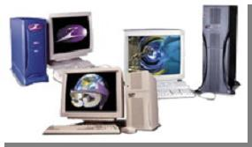



需求收集常用渠道
01－客户日常交流
02－技术交流
03－市场调研
04－技术支持
05－媒体信息
06－参观展览
07－市场投标
08－高层拜访
09－标杆分析
10－专业论坛/标准研讨

Slide 59

1、 客户日常交流
客户日常拜访、交流是收集需求的重要方式
在交流过程中，客户提出的问题、要求、意见，应及时如实记录
深入发掘客户背后的想法、真正希望解决的问题
随便询问竞争对手是怎么做的（或者竞争对手的答复）
了解客户期望需求实现的时间
不要轻易承诺或答复

Slide 60
2、 技术交流
技术交流，是挖掘客户需求的重要方法之一。
通过与客户进行技术交流，记录客户的需求反馈；通过观察客户在技术交流中的表现和行为，有意识聚焦客户的核心关注点，能充分了解到客户的关键需求。

Slide 61
3、 市场调研
市场调研以科学的方法，系统地、有目的地收集、整理、分析和研究所有与市场有关的信息，特别是有关消费者的需求、购买动机和购买行为等方面的市场信息，从而提出解决问题的建议。市场调研通常涉及面比较广，投入人力比较多，在决定通过市场调研调查客户需求时，也可以考虑请专业的市场调研公司进行市场调研。
市场调研的四个步骤
  提出问题
  确定调研的课题
  市场调查设计
  分析预测问题

Slide 62

4、技术支持
技术支持，尤其是售后技术支持，也是获取客户需求最为重要的渠道之一。在技术支持中，通过产品的安装、维护和使用，通过观察客户在维护使用过程中的行为，倾听并记录客户使用产品的反馈意见，可以发现并挖掘很多的产品客户需求，尤其是产品易用性需求、产品可维护性需求等。

Slide 63

5、媒体信息
媒体信息包括报刊、电视、广播、网络、宣传材料、第三方咨询公司报告等媒体信息，通过查看和检索媒体信息，可以充分了解行业发展趋势，了解运营商发展趋势，了解竞争对手信息，了解标准发展方向，从而更准确地把握客户的需求。

Slide 64

6、参观展览
行业展览是产业链厂商展示自己的舞台。在允许的范围内，利用各种可能的机会，通过观察、交流等手段获取信息
了解全球主流运营商对行业发展或通信技术趋势的看法
了解同行，特别是行业领先者的解决方案、产品性能指标、新产品展示、产品路标，甚至系统架构和关键技术的解决措施
了解产业上下游合作伙伴的解决方案、产品性能指标、新产品展示、产品路标，甚至系统架构和关键技术的解决措施
任何人参观展览/论坛/研讨需要写总结报告，内容包括：
1：基本情况
2：新的趋势和发展方向
3：主要竞争对手的动向
4：讲座及交流情况
5：我们的对策及建议
6：总结情况

Slide 65

7、市场投标
市场投标是当前我们获取客户需求的主要方法和来源，我们可以看到很多的客户需求来源都是市场投标。
标书中通常包括了主要的功能需求、产品性能需求、可靠性需求等。
对标书中需求的充分了解和质量的把握，提高产品竞争力
投标完成后在投标总结报告中需要包含以下内容：
1：客户的新的需求
2：客户为什么要提出这个需求
3：竞争对手投标的方案
4：我方的方案与竞争对手的区别
5：市场需要注意的问题
6：研发需要注意的问题
7：给公司的建议

Slide 66

8、高层拜访
安排我司高层领导拜访客户的高层经理，不仅能加强改进客户关系，也是有效获取关键核心的有价值的客户需求的机会。
在准备高层拜访的材料时，要求增加获取客户关键需求的内容。高层拜访随从人员需要作详细记录，结束后整理归纳。
重点包括但不限于：
1、客户高层对行业发展、业务趋势、技术趋势的看法
2、客户的中长期业务发展战略和网络/技术部署战略或思路
3、客户目前面临的关键问题和挑战
4、竞争对手有哪些解决措施，哪些得到客户的认可

Slide 67

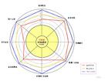
9、 标杆分析
行业标杆即行业领先者，对行业、业务、技术发展趋势的看法，往往部分地反映行业的未来趋势，并通过强有力的客户引导，被客户采纳，从而成为客户需求
技术白皮书、解决方案、技术建议书、投标书、产品说明书等，是标杆研究的对象
通过解剖、分析、对比，及早的发现我司的短处，从侧面挖掘客户的需求
在进行标杆分析时，可以使用$APPEALS方法

Slide 68


10、专业论坛/标准研讨
完整、清晰了解市场需求实质,加快产品研发速度
  论坛/标准研讨活动，是一个很好地了解用户需求的平台。参与标准研究，分析他们的提案，就可以清楚了解他们的需求
  在论坛/标准会议场合，可以接触到跨国运营商人员、接触到对手厂家人员,接触到一些中间研究机构的人员，经过激烈研讨和头脑风暴后，你得到的信息是较为完整、清晰
  更重要的目的是了解用户需求和行业发展动态，以便能及时启动研发或者调整方向
  第一时间深刻理解标准，获得产品规划的信息、资料和数据，启动产品开发，避免错过产品面市的最佳时机,甚至被淘汰出局

Slide 69
Key Points?
Move from Problem Domain to Solution Domain
Focus on Understanding a set of features that address the stakeholders’ needs
Very challenging activity
Requires collaboration of people with different backgrounds:
  User with application domain knowledge
  Developer with implementation domain knowledge
Bridges the gap between user and developer
Software Requirements Analysis

Slide 70
Next?
Step-By-Step Building of the Use-Case Model
Relationships between use cases
Pre- and postconditions for use cases
Use Case v.s. NFRs, Constraints, Business Rules, etc.
Templates for use cases
Software Requirements Analysis

